Slide 1
Superstore Sales Dashboard Insights
Task-8: Dashboard Design
Rakshitha K B

Slide 2
Superstore Sales Dashboard
Objective: A basic simple superstore sales dashboard that shows the sales performance by product, region, and month.
Key Insights:
Technology category leads in sales, contributing over 36% of total sales.
West region achieved the highest sales performance, followed by East.
March and December saw peak sales activity, indicating strong end-of-quarter demand.
South region showed the lowest sales, suggesting potential for growth initiatives.

Slide 3
Visual Highlights & Interactivity
Visual Breakdown:
📍 Sales by Region & State: West region leads, California dominates.
📊 Profit by Category & Sub-Category: Phones & Chairs stand out.
🥧 Quantity Share: Technology = ~60% of total.
Filters & Interactivity:
✅ Segment, Category, Sub-Category
🔍 Enables user-driven deep-dive analysis
🧩 Enhances pattern discovery across products & customers

Slide 4
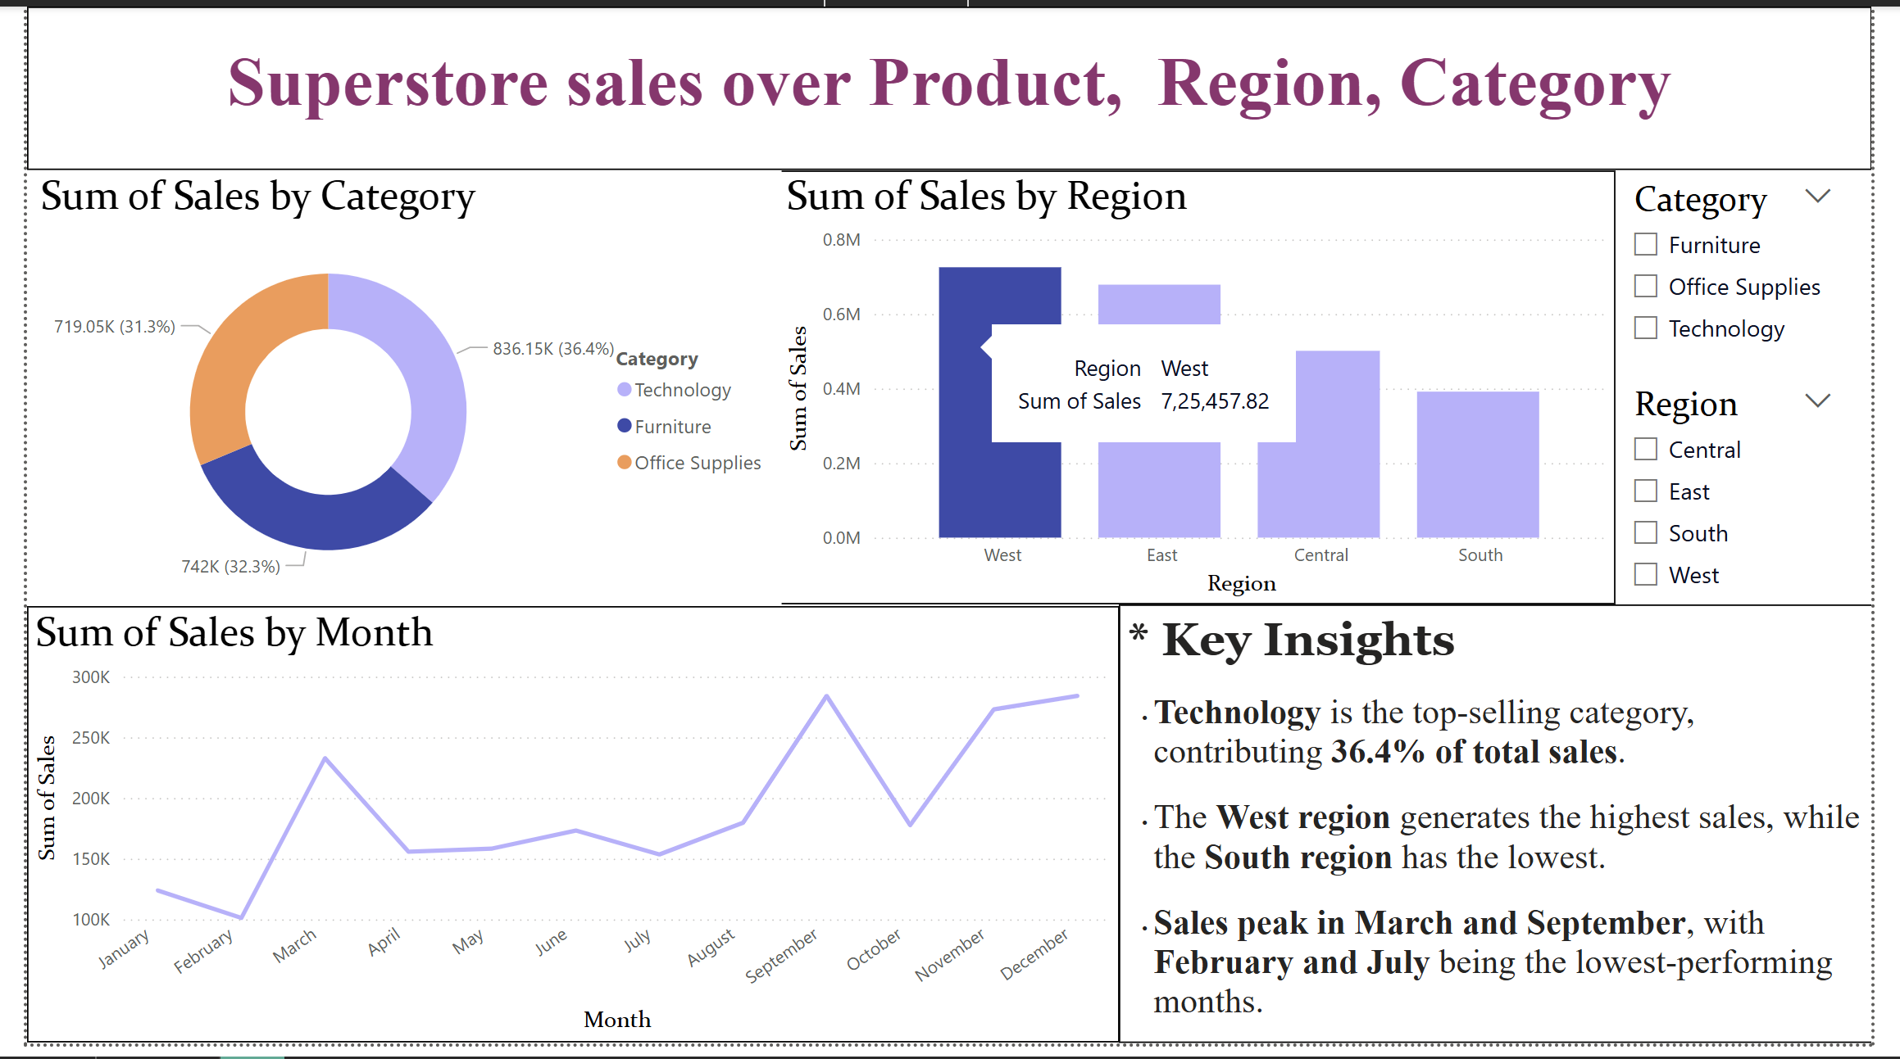

Slide 5
Thank you..

